Slide 1
3.7 Converting A Regular Expression into A NFA (Thompson’s Construction) (P.121)
We now focus on transforming a Reg. Expr. to an NFA
This construction allows us to take:
  Regular Expressions (which describe tokens)
  To an NFA (to characterize language)
  To a DFA (which can be “computerized”)
    - Minizing DFA
The construction process is component-wise
  Builds NFA from components of the regular expression in a special order with particular techniques.
NOTE: Construction is “syntax-directed” translation, i.e., syntax of regular expression is determining factor for NFA construction and structure.
◎2005 ECNU SEI
Compilers: Principles, Techniques, and Tools

Slide 2
Thompson’s Construction (cont.)
This is one way to convert a regular expression into a NFA.
There can be other ways (much efficient) for the conversion.
Thompson’s Construction is simple and systematic method. It guarantees that the resulting NFA will have exactly one final state, and one start state.
Construction starts from simplest parts (alphabet symbols). To create a NFA for a complex regular expression, NFAs of its sub-expressions are combined to create its NFA.
◎2005 ECNU SEI
Compilers: Principles, Techniques, and Tools

Slide 3
Thompson’s Construction (cont.)
To recognize an empty string ε
To recognize a symbol a in the alphabet Σ
ε
i
f
a
i
f
If N(r₁) and N(r₂) are NFAs for regular expressions r₁ and r₂
  For regular expression r₁ | r₂
ε
N(r₁)
ε
NFA for r₁ | r₂
i
ε
f
ε
N(r₂)
◎2005 ECNU SEI
Compilers: Principles, Techniques, and Tools

Slide 4
Thompson’s Construction (cont.)
For regular expression r₁ r₂
Final state of N(r₂) become final state of N(r₁r₂)
i
N(r₁)
N(r₂)
f
NFA for r₁ r₂
For regular expression r*
ε
ε
ε
i
N(r)
f
ε
NFA for r*
◎2005 ECNU SEI
Compilers: Principles, Techniques, and Tools

Slide 5
Construction Algorithm : R.E. → NFA
Construction Process :
1st : Identify subexpressions of the regular expression
∈
Σ symbols
r | s
rs
r*
2nd : Characterize “pieces” of NFA for each subexpression
◎2005 ECNU SEI
Compilers: Principles, Techniques, and Tools

Slide 6
Piecing Together NFAs
1. For ∈ in the regular expression, construct NFA
start
i
∈
f
L(∈)
2. For a ∈ Σ in the regular expression, construct NFA
start
i
a
f
L(a)
◎2005 ECNU SEI
Compilers: Principles, Techniques, and Tools

Slide 7
Piecing Together NFAs – continued(1)
3.(a) If s, t are regular expressions, N(s), N(t) their NFAs s|t has NFA:
N(s)
∈
start
i
∈
f
L(s) ∪ L(t)
∈
N(t)
∈
where i and f are new start / final states, and ∈-moves are introduced from i to the old start states of N(s) and N(t) as well as from all of their final states to f.
◎2005 ECNU SEI
Compilers: Principles, Techniques, and Tools

Slide 8
Piecing Together NFAs – continued(2)
3.(b) If s, t are regular expressions, N(s), N(t) their NFAs st (concatenation) has NFA:
start
i
N(s)
N(t)
f
L(s) L(t)
overlap
Alternative:
start
i
∈
N(s)
∈
N(t)
∈
f
where i is the start state of N(s) (or new under the alternative) and f is the final state of N(t) (or new). Overlap maps final states of N(s) to start state of N(t).
◎2005 ECNU SEI
Compilers: Principles, Techniques, and Tools

Slide 9
Piecing Together NFAs – continued(3)
3.(c) If s is a regular expressions, N(s) its NFA, s* (Kleene star) has NFA:
∈
start
i
∈
N(s)
∈
f
∈
where : i is new start state and f is new final state
∈-move i to f (to accept null string)
∈-moves i to old start, old final(s) to f
∈-move old final to old start (why?)
◎2005 ECNU SEI
Compilers: Principles, Techniques, and Tools

Slide 10
Properties of Construction (P.124)
Let r be a regular expression, with NFA N(r), then
N(r) has #of states ≤ 2*(#symbols + #operators) of r
N(r) has exactly one start and one accepting state
Each state of N(r) has at most one outgoing edge a∈Σ or at most two outgoing ∈’s
BE CAREFUL to assign unique names to all states !
◎2005 ECNU SEI
Compilers: Principles, Techniques, and Tools

Slide 11
Thompson’s Construction Example3.16 - (a|b) * a (P.124)
a:
a
a
ε
ε
(a | b)
ε
ε
b:
b
b
ε
a
ε
ε
(a|b) *
ε
ε
ε
ε
b
ε
ε
2
a
3
ε
ε
(a|b) * a
0
ε
1
6
ε
7
a
8
ε
ε
4
b
5
ε
◎2005 ECNU SEI
Compilers: Principles, Techniques, and Tools

Slide 12
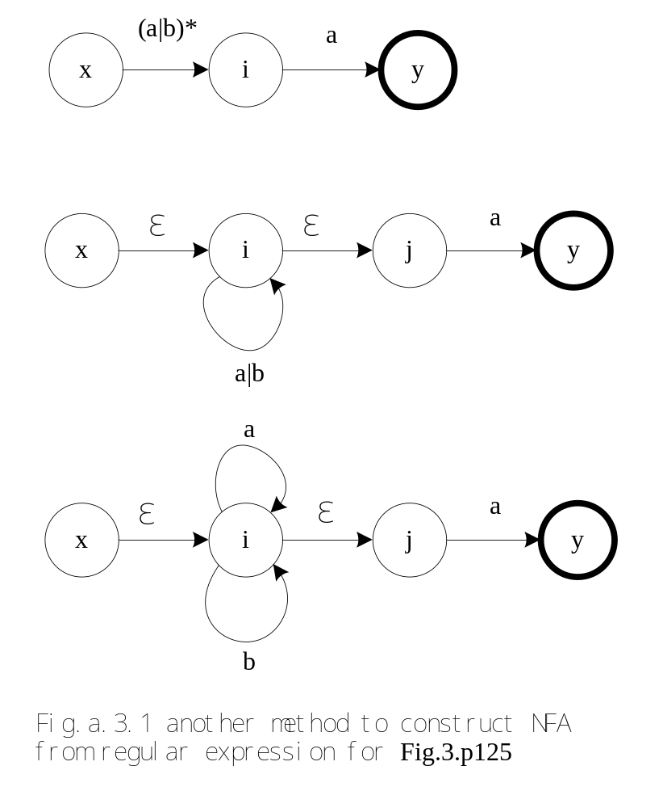
◎2005 ECNU SEI
Compilers: Principles, Techniques, and Tools

Slide 13
R.E. → NFA (exercise)
2nd Example - (ab*c) | (a(b|c*))
Parse Tree for this regular expression:
r₁₃
r₅
|
r₁₂
r₃
r₄
r₁₁
r₁₀
(
)
a
a
r₉
r₁
r₂
r₇
|
r₈
r₀
c
*
r₆
b
*
b
c
What is the NFA? Let’s construct it !
◎2005 ECNU SEI
Compilers: Principles, Techniques, and Tools

Slide 14
R.E. → NFA (exercise answer)– Construction(1)
(ab*c) | (a(b|c*))
r₀:
b
∈
r₃:
a
r₁:
∈
b
∈
∈
r₂:
c
∈
r₄ : r₁ r₂
∈
b
∈
c
∈
∈
a
∈
b
∈
c
r₅ : r₃ r₄
∈
◎2005 ECNU SEI
Compilers: Principles, Techniques, and Tools

Slide 15
R.E. → NFA (exercise answer)– Construction(2)
(ab*c) | (a(b|c*))
∈
r₇:
b
r₈:
∈
c
∈
r₁₁:
a
∈
b
r₆:
c
∈
∈
∈
r₉ : r₇ | r₈
∈
c
∈
∈
r₁₀ : r₉
b
∈
∈
∈
r₁₂ : r₁₁ r₁₀
a
∈
c
∈
∈
◎2005 ECNU SEI
Compilers: Principles, Techniques, and Tools

Slide 16
R.E. → NFA (exercise answer)– Final Step
r₁₃ : r₅ | r₁₂
∈
a
∈
b
∈
c
1
2
3
4
5
6
∈
∈
∈
start
16
0
b
9
10
∈
∈
∈
∈
∈
a
∈
c
∈
7
8
11
12
13
14
15
∈
◎2005 ECNU SEI
Compilers: Principles, Techniques, and Tools

Slide 17
Direct Simulation of an NFA (P.126)
s ← s₀
c ← nextchar;
while c ≠ eof do
s ← move(s,c);
c ← nextchar;
end;
if s is in F then return “yes”
else return “no”
DFA
simulation
Fig.3.31 simulating the NFA of algorithm Thompson’s construction
S ← ∈-closure({s₀})
c ← nextchar;
while c ≠ eof do
S ← ∈-closure(move(S,c));
c ← nextchar;
end;
if S∩F≠∅ then return “yes”
else return “no”
NFA
simulation
◎2005 ECNU SEI
Compilers: Principles, Techniques, and Tools

Slide 18
Final Notes : R.E. to NFA Construction
So, an NFA may be simulated by algorithm, when NFA is constructed using Previous techniques
Algorithm run time is proportional to |N| * |x| where |N| is the number of states and |x| is the length of input
Alternatively, we can construct DFA from NFA and use the resulting Dtran to recognize input:
space required
time to simulate
NFA
O(|r|)
O(|r|*|x|)
DFA
O(2^{|r|})
O(|x|)
where |r| is the length of the regular expression.
◎2005 ECNU SEI
Compilers: Principles, Techniques, and Tools

Slide 19
Pulling Together Concepts
Designing Lexical Analyzer Generator
  Reg. Expr. → NFA construction
  NFA → DFA conversion
  DFA simulation for lexical analyzer
Recall Lex Structure
  Pattern Action
  Pattern Action
  … …
  Each pattern recognizes lexemes
  Each pattern described by regular expression
(a | b)*abb
∈
e.g.
∈
(abc)*ab
∈
etc.
Recognizer!
◎2005 ECNU SEI
Compilers: Principles, Techniques, and Tools

Slide 20
Exercise in class
Using Thompson’s construction to construct NFA from regular expression.
a(a|b)⁺(b|c)(c|∈)
◎2005 ECNU SEI
Compilers: Principles, Techniques, and Tools

Slide 21
Converting Regular Expressions Directly to DFAs (P.135)
We may convert a regular expression into a DFA (without creating a NFA first).
First we augment the given regular expression by concatenating it with a special symbol #.
r ➔ (r)# augmented regular expression
Then, we create a syntax tree for this augmented regular expression.
In this syntax tree, all alphabet symbols (plus # and the empty string) in the augmented regular expression will be on the leaves, and all inner nodes will be the operators in that augmented regular expression.
Then each alphabet symbol (plus #) will be numbered (position numbers).
◎2005 ECNU SEI
Compilers: Principles, Techniques, and Tools

Slide 22
Regular Expression ➔ DFA (cont.)
(a|b) * a ➔ (a|b) * a # augmented regular expression
•
Syntax tree of (a|b) * a #
each symbol is numbered (positions)
each symbol is at a leave
inner nodes are operators
•
#
4
*
a
3
|
a
b
1
2
◎2005 ECNU SEI
Compilers: Principles, Techniques, and Tools

Slide 23
followpos
Then we define the function followpos for the positions (positions
assigned to leaves).
followpos(i) -- is the set of positions which can follow
the position i in the strings generated by
the augmented regular expression.
For example, ( a | b) * a #
1 2 3 4
followpos(1) = {1,2,3}
followpos(2) = {1,2,3}
followpos(3) = {4}
followpos(4) = {}
followpos is just defined for leaves,
it is not defined for inner nodes.
◎2005 ECNU SEI
Compilers: Principles, Techniques, and Tools

Slide 24
firstpos, lastpos, nullable
To evaluate followpos, we need three more functions to be defined for the nodes (not just for leaves) of the syntax tree.
firstpos(n) -- the set of the positions of the first symbols of strings generated by the sub-expression rooted by n.
lastpos(n) -- the set of the positions of the last symbols of strings generated by the sub-expression rooted by n.
nullable(n) -- true if the empty string is a member of strings generated by the sub-expression rooted by n. false otherwise.
◎2005 ECNU SEI
Compilers: Principles, Techniques, and Tools

Slide 25
How to evaluate firstpos, lastpos, nullable (P.138)
n | nullable(n) | firstpos(n) | lastpos(n)
leaf labeled ε | true | Φ | Φ
leaf labeled with position i | false | {i} | {i}
| c₁ c₂ | nullable(c₁) or nullable(c₂) | firstpos(c₁) ∪ firstpos(c₂) | lastpos(c₁) ∪ lastpos(c₂)
• c₁ c₂ | nullable(c₁) and nullable(c₂) | if (nullable(c₁)) firstpos(c₁) ∪ firstpos(c₂) else firstpos(c₁) | if (nullable(c₂)) lastpos(c₁) ∪ lastpos(c₂) else lastpos(c₂)
* c₁ | true | firstpos(c₁) | lastpos(c₁)
Fig.3.40. rules for computing nullable and firstpos.
◎2005 ECNU SEI
Compilers: Principles, Techniques, and Tools

Slide 26
How to evaluate followpos (P.138)
Two-rules define the function followpos:
If n is concatenation-node with left child c₁ and right child c₂, and i is a position in lastpos(c₁), then all positions in firstpos(c₂) are in followpos(i).
If n is a star-node, and i is a position in lastpos(n), then all positions in firstpos(n) are in followpos(i).
If firstpos and lastpos have been computed for each node, followpos of each position can be computed by making one depth-first traversal of the syntax tree.
n
•
n*
c1
c2
c
◎2005 ECNU SEI
Compilers: Principles, Techniques, and Tools

Slide 27
Example -- ( a | b) * a #
{1,2,3}
green – firstpos
blue – lastpos
•
{4}
{1,2,3}
•
{3}
{4}
#
{4}
4
{1,2}
{1,2}
*
{3}
a
{3}
3
Then we can calculate followpos
followpos(1) = {1,2,3}
followpos(2) = {1,2,3}
followpos(3) = {4}
followpos(4) = {}
|
{1,2}
{1,2}
{1}
a
{1}
b
{2}
{2}
1
2
After we calculate follow positions, we are ready to create DFA
for the regular expression.
◎2005 ECNU SEI
Compilers: Principles, Techniques, and Tools

Slide 28
Algorithm (RE ➔ DFA) (P.140)
Create the syntax tree of (r) #
Calculate the functions: followpos, firstpos, lastpos, nullable
Put firstpos(root) into the states of DFA as an unmarked state.
while (there is an unmarked state S in the states of DFA) do
  mark S
  for each input symbol a do
    let s₁,...,s_{n} are positions in S and symbols in those positions are a
    S’ ⬅ followpos(s₁) ∪ ... ∪ followpos(s_{n})
    move(S,a) ⬅ S’
    if (S’ is not empty and not in the states of DFA)
      put S’ into the states of DFA as an unmarked state.
the start state of DFA is firstpos(root)
the accepting states of DFA are all states containing the position of #
Fig.3.44. construction of DFA.
◎2005 ECNU SEI
Compilers: Principles, Techniques, and Tools

Slide 29
Example -- ( a | b) * a # (P.139)
1 2 3 4
followpos(1)={1,2,3} followpos(2)={1,2,3} followpos(3)={4} followpos(4)={}
S₀=firstpos(root)={1,2,3}
⇓ mark S₀
a: followpos(1) ∪ followpos(3)={1,2,3,4}=S₁ move(S₀,a)=S₁
b: followpos(2)={1,2,3}=S₀ move(S₀,b)=S₀
⇓ mark S₁
a: followpos(1) ∪ followpos(3)={1,2,3,4}=S₁ move(S₁,a)=S₁
b: followpos(2)={1,2,3}=S₀ move(S₁,b)=S₀
start state: S₀
accepting states: {S₁}
b
a
a b
S0 S1 S0
S1 S1 S0
a
S₀
S₁
b
◎2005 ECNU SEI
Compilers: Principles, Techniques, and Tools

Slide 30
Exercise -- ( a | ε) b c* #
Please compute firstpos, lastpos, followpos, then convert to DFA
◎2005 ECNU SEI
Compilers: Principles, Techniques, and Tools

Slide 31
Exercise and answer -- ( a | ε) b c* #
1 2 3 4
followpos(1)={2} followpos(2)={3,4} followpos(3)={3,4} followpos(4)={}
S₀=firstpos(root)={1,2}
⇓ mark S₀
a: followpos(1)={2}=S₁ move(S₀,a)=S₁
b: followpos(2)={3,4}=S₂ move(S₀,b)=S₂
⇓ mark S₁
b: followpos(2)={3,4}=S₂ move(S₁,b)=S₂
⇓ mark S₂
c: followpos(3)={3,4}=S₂ move(S₂,c)=S₂
start state: S₀
accepting states: {S₂}
1
a
b
0
b
2
c
◎2005 ECNU SEI
Compilers: Principles, Techniques, and Tools

Slide 32
Minimizing the Number of States of a DFA (P.141)
partition the set of states into two groups:
  G₁ : set of accepting states
  G₂ : set of non-accepting states
For each new group G
  partition G into subgroups such that states s₁ and s₂ are in the same group if
  for all input symbols a, states s₁ and s₂ have transitions to states in the same group.
Start state of the minimized DFA is the group containing the start state of the original DFA.
Accepting states of the minimized DFA are the groups containing the accepting states of the original DFA.
◎2005 ECNU SEI
Compilers: Principles, Techniques, and Tools

Slide 33
Minimizing the Number of States of DFA (cont.)
Construct initial partition Π of S with two groups: accepting/ non-accepting.
(Construct Π_{new} )For each group G of Π do begin
  Partition G into subgroups such that two states s,t
  of G are in the same subgroup if for all symbols a
  states s,t have transitions on a to states of the same group of Π.
  Replace G in Π_{new} by the set of all these subgroups.
Compare Π_{new} and Π. If equal, Π_{final}:= Π then proceed to 4, else set Π := Π_{new} and goto 2.
Aggregate states belonging in the groups of Π_{final}
◎2005 ECNU SEI
Compilers: Principles, Techniques, and Tools

Slide 34
Minimizing DFA - Example
a
G₁ = {1}
G₂ = {0,2}
G₂ cannot be partitioned because
move(0,a)=1 move(0,b)=2
move(2,a)=1 move(2,b)=2
1
a
0
b
a
b
2
a b
0->1 0->2
2->1 2->2
b
So, the minimized DFA (with minimum states)
b
a
{0,2}
a
{1}
b
◎2005 ECNU SEI
Compilers: Principles, Techniques, and Tools

Slide 35
Minimizing DFA (Exercise)
Minimizing DFA, and list state transition table
a
1
a
a
0
b
3
b
a
2
b
b
◎2005 ECNU SEI
Compilers: Principles, Techniques, and Tools

Slide 36
Minimizing DFA (exercise answer)
a
1
a
a
Groups: {0,1,2} {3}
0
b
3
b
a
a b
0->1 0->2
1->1 1->2
2->3 2->2
{0,1}
{2}
2
b
no more partitioning
b
So, the minimized DFA
b
a
{2}
b
{0,1}
a
b
a
{3}
◎2005 ECNU SEI
Compilers: Principles, Techniques, and Tools

Slide 37
Exercises in class
Construct DFA for the following regular expression in two ways:
1. a(a|b)*(b|∈)
2. a(a|b)*a(a|b)a
The first way is to construct NFA by using Thompson’s algorithm , then to construct DFA from NFA by using subset construction algorithm .
The second way is to construct DFA from regular expression directly.
Minimizing the states of DFA.
◎2005 ECNU SEI
Compilers: Principles, Techniques, and Tools

Slide 38
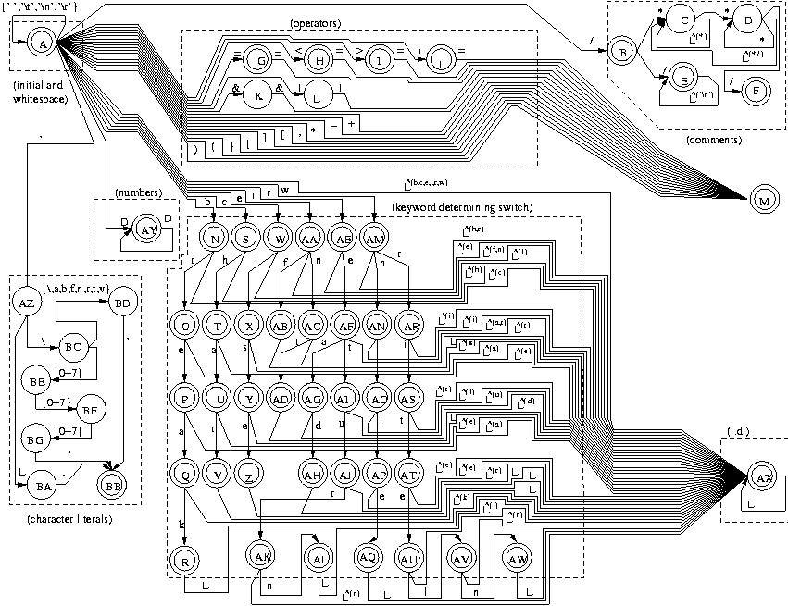
DFA
◎2005 ECNU SEI
Compilers: Principles, Techniques, and Tools

Slide 39
Some Other Issues in Lexical Analyzer
The lexical analyzer has to recognize the longest possible string.
  Ex: identifier newval -- n ne new newv newva newval
What is the end of a token? Is there any character which marks the end of a token?
  It is normally not defined.
  If the number of characters in a token is fixed, in that case no problem: + -
  But < ➔ < or <> (in Pascal)
  The end of an identifier : the characters cannot be in an identifier can mark the end of token.
  We may need a lookhead
    In Prolog: p :- X is 1. p :- X is 1.5. The dot followed by a white space character can mark the end of a number. But if that is not the case, the dot must be treated as a part of the number.
◎2005 ECNU SEI
Compilers: Principles, Techniques, and Tools

Slide 40
Some Other Issues in Lexical Analyzer (cont.)
Skipping comments
  Normally we don’t return a comment as a token.
  We skip a comment, and return the next token (which is not a comment) to the parser.
  So, the comments are only processed by the lexical analyzer, and the don’t complicate the syntax of the language.
◎2005 ECNU SEI
Compilers: Principles, Techniques, and Tools

Slide 41
Some Other Issues in Lexical Analyzer (cont.)
Symbol table interface
  symbol table holds information about tokens (at least lexeme of identifiers)
  how to implement the symbol table, and what kind of operations.
    hash table – open addressing, chaining
    putting into the hash table, finding the position of a token from its lexeme.
Positions of the tokens in the file (for the error handling).
◎2005 ECNU SEI
Compilers: Principles, Techniques, and Tools

Slide 42
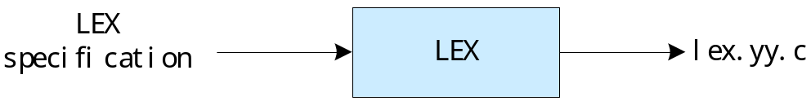
Using LEX
Lex Program Structure:
declarations
%%
translation rules
%%
auxiliary procedures
Name the file e.g. test.lex
Then, “lex test.lex” produces the file
“lex.yy.c” (a C-program)
◎2005 ECNU SEI
Compilers: Principles, Techniques, and Tools

Slide 43
LEX
%{
/* definitions of all constants
LT, LE, EQ, NE, GT, GE, IF, THEN, ELSE, ... */
%}
......
letter [A-Za-z]
digit [0-9]
id {letter}({letter}|{digit})*
......
%%
if { return(IF);}
then { return(THEN);}
{id} { yylval = install_id(); return(ID); }
......
%%
install_id()
{ /* procedure to install the lexeme to the ST */
C declarations
declarations
Rules
Auxiliary
◎2005 ECNU SEI
Compilers: Principles, Techniques, and Tools

Slide 44
Example of a Lex Program
int num_lines = 0, num_chars = 0;
%%
\n {++num_lines; ++num_chars;}
. {++num_chars;}
%%
main( argc, argv )
int argc; char **argv;
{
++argv, --argc; /* skip over program name */
if ( argc > 0 )
yyin = fopen( argv[0], "r" );
else yyin = stdin;
yylex();
printf( "# of lines = %d, # of chars = %d\n",
num_lines, num_chars ); }
◎2005 ECNU SEI
Compilers: Principles, Techniques, and Tools

Slide 45
Another Example
%{ #include <stdio.h> %}
WS [ /t/n]*
%%
[0123456789]+ printf("NUMBER\n");
[a-zA-Z][a-zA-Z0-9]* printf("WORD\n");
{WS} /* do nothing */
. printf(“UNKNOWN\n“);
%%
main( argc, argv )
int argc; char **argv;
{ ++argv, --argc;
if ( argc > 0 ) yyin = fopen( argv[0], "r" );
else yyin = stdin;
yylex(); }
◎2005 ECNU SEI
Compilers: Principles, Techniques, and Tools

Slide 46
Concluding Remarks
Focused on Lexical Analysis Process, Including
  - Regular Expressions
  Finite Automaton （NFA, DFA）
  Conversion (RE NFA,NFA DFA, RE DFA)
  Lex
  Interplay among all these various aspects of lexical analysis
Looking Ahead:
The next step in the compilation process is Parsing:
  Top-down vs. Bottom-up
  - Relationship to Language Theory
◎2005 ECNU SEI
Compilers: Principles, Techniques, and Tools

Slide 47
本章小结
熟悉概念：正规表达式，单词，字母集，字符串，语言，转换图TD，自动机FA，NFA, DFA等；
掌握Thompson构造法由正规表达式构造NFA的方法；
掌握子集构造法由NFA构造DFA的算法；
掌握由正规表达式直接构造DFA的算法；
掌握DFA状态最小化的方法。
◎2005 ECNU SEI
Compilers: Principles, Techniques, and Tools

